Slide 1
Reimagining Secondary Education
Dr. Steve Gratz, Senior Executive Director
Spring 2018

Slide 2
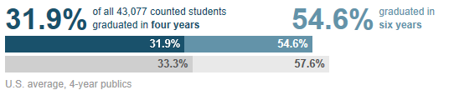
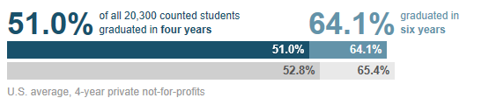
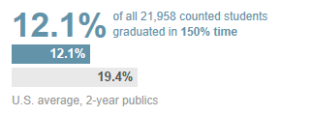
College Completion Rates
Ohio public colleges (4-year)
Ohio private colleges (4-year)
Ohio public colleges (2-year)
The Chronicle of Higher Education

Slide 3
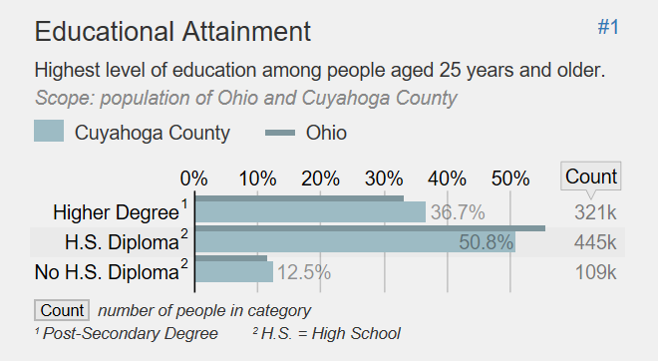
Education Attainment
The Chronicle of Higher Education

Slide 4
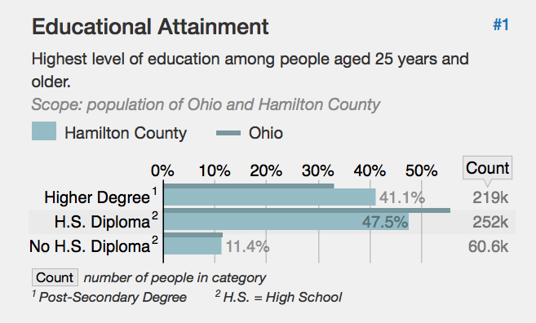
Education Attainment
The Chronicle of Higher Education

Slide 5
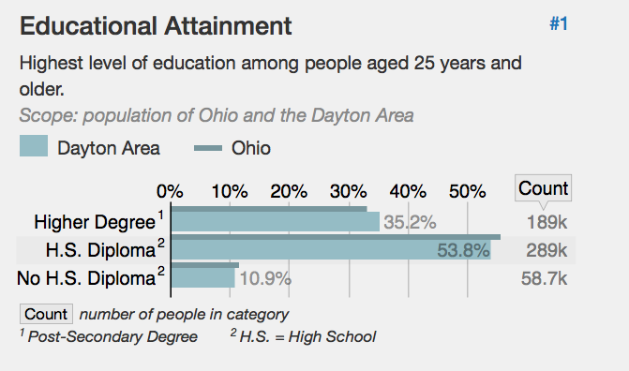
Education Attainment
The Chronicle of Higher Education

Slide 6
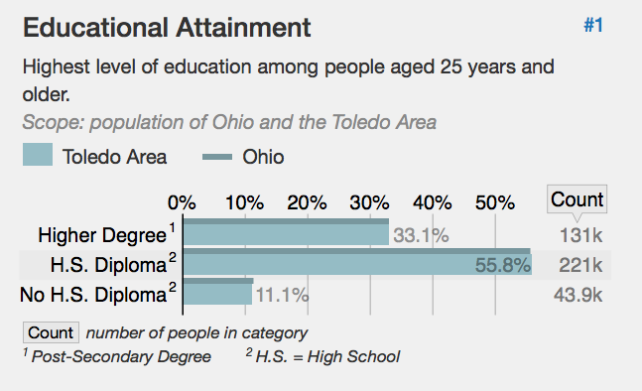
Education Attainment
The Chronicle of Higher Education

Slide 7
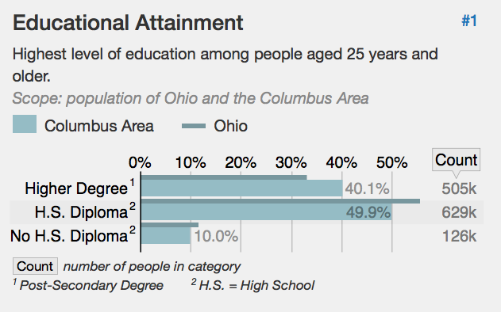
Education Attainment
The Chronicle of Higher Education

Slide 8
















Ohio Attainment Goal
Notes:
What can we do to meet this goal?
ODHE has a number of initiatives - I’ll hit the highlights … (can save time by only talking about a couple)
Complete College Ohio – a report created several years ago focused on developing a set of strategic recommendations for increasing the percentage of Ohioans with degrees including a required annual Campus Completion Plan for IHE among others
Guaranteed Transfer Pathways – statewide pathways from 2 year to 4 year degree programs – directly related to college affordability and degree completion – this includes the TAGs or Transfer Assurance Guides work
Affordability & Efficiency – The Chancellor of Higher Education maintains an efficiency advisory committee to oversee the work of public IHE to find optimal efficiency plans, identifying shared services, streamlining administrative operations, and sharing efficiency best practices
Bridges to Success – Helps public IHE improve student success by systemically linking three success strategies – structure degree pathways, redesigned mathematics gateway courses, and corequisite remediation – the sooner students take courses that count toward a college degree – the greater the chance that they will earn a degree
GEAR UP Ohio – This state grant project is focused on embedding a college-going culture in targeted schools and communities to increase the number of low-income students prepared to enter and succeed in postsecondary education – goal is to eliminate college access barriers
Choose Ohio First – A scholarship program to encourage Ohio’s best and brightest STEMM scholars, to attend an Ohio IHE in their field instead of leaving the state for education. For those students, Ohio hopes that they will be likely to live here and earn here, and will positively impact Ohio's economy.
Forever Buckeye – extends the in-state resident tuition rate to any public or private Ohio HS graduation who leaves the state but returns to enroll in an undergraduate or graduate program at nan Ohio college and also establishes residency in Ohio.
3 Year Degree Plan – Public IHE have assembled plans that will allow students to complete a bachelor’s degree in 3 years – this is completed by incorporating advanced standing programs during high school such as Advanced Placement and College Credit Plus courses as well as career-technical credit transfer and early college high school partnerships
One Year Option – allows graduates of Ohio Technical Centers (adult career centers) who complete a 900 hour program of study and obtain an industry-recognized credential to receive 30 college technical credit hours toward a technical degree upon enrollment in an IHE.
Ohio Mathematics – collaborate effort of math faculty members from state public IHE to revisit and rethink math courses–will help better align course options to students’ academic and career goals.
SCTAI Secondary Career-Technical Alignment Initiative goal is to create additional CTAGS (Career-Technical Assurance Guides) or statewide articulation agreements, specifically for secondary high school students who complete agreed upon CT coursework and assessments.
Ohio Means Internships & Co-ops – State and private dollars to increase the number of internships for employers and student in key industries to close the skills gap, increase student completion, and give Ohio competitive advantage in the global human capital talent market
Prior Learning Assessment PLA – measures student learning that has occurred outside of the college classroom to determine whether the learning can apply for college credit
Give Back Go Forward – Ohioans age 60 and older can give back to their communities by volunteering at least 100 hours per year at local non-profit organizations – they earn a 3 credit hour tuition waiver from participate IHE – can use the waiver themselves or donate to another Ohio resident.
Veterans - effort to help veterans, service members and their families achieve college degrees, the University System of Ohio has taken proactive steps to better serve those who have served our country.
Veteran Services on Ohio Campuses
Financial Aid for Veterans
Transform Military Training, Experience, and Coursework into College Credit | Ohio Transfer to Degree Guarantee
Ohio Means Veteran Jobs
Military Veterans Wanted! Scholarship Funds Available

Slide 9
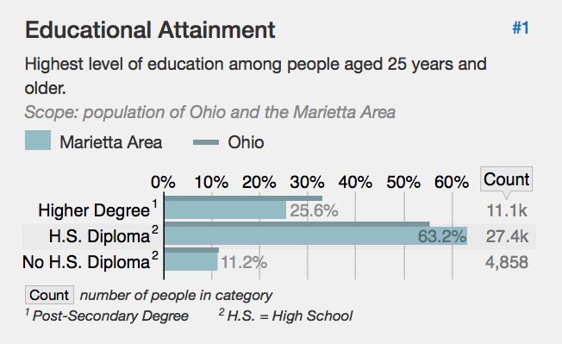
Education Attainment
The Chronicle of Higher Education

Slide 10
Goal for Each Child
Annually increase the percentage of Ohio’s high school graduates who, within one year of graduation, are:
Enrolled and succeeding in a post-high school learning experience, including an adult career-technical education program, an apprenticeship and/or a two-year or four-year college program (15 semester hours); or
Serving in a military branch; or
Earning a living wage.
From Ohio’s Strategic Plan for Education

Slide 11

New Skills for Youth Grant
Expand access to quality pathways for all students in the state.
Coalesce support for career readiness and raise awareness about opportunities available to students.

Slide 12
New Skills For Youth
Identify and Align Career Pathways and Programs
  Establish statewide advisory committees
  Increase student backpacks in OhioMeansJobs

Slide 13
New Skills For Youth
Pathway Quality and Availability
  Increase HSHD pathways
  Increase students enrolled in HSHD pathways
  Increase access and participation in HSHD pathways by economically disadvantaged, African-American and Hispanic students
  Decrease programs that are not HSHD pathways

Slide 14
New Skills For Youth
Scale Pathways
  Provide guidance and professional development on integrating technical and academic content so students earn simultaneous credit
  Establish and scale a College Credit Plus in HSHD pathways, e.g., Stark State’s Learn to Earn
  Create and deploy an OhioMeansJobs Readiness Seal

Slide 15
New Skills For Youth
Accountability
  Create a readiness dashboard that informs stakeholders of student success in HSHD pathways, e.g., participation in work-based learning, postsecondary, pre-apprenticeship and earning credentials of value.
  Make recommendations to the SBOE on readiness indicators

Slide 16
New Skills For Youth
K-12/Higher Ed Collaboration
  Increase the percentage of students graduating with industry-recognized credentials
  Increase statewide articulated credit courses
  Ensure cross-institutional alignment of HSHD pathways resulting in seamless transitions for students.

Slide 17

SuccessBound
“Getting kids excited about job opportunities can begin to capture their imagination. By connecting employers with qualified workers, we’re changing the lives of our students and strengthening Ohio’s economy.” – Gov. Kasich

Slide 18

Align Stages of Learning
High School
Work
Learning
College

Slide 19
Foundations of SuccessBound
Enhances coordination between K-12, postsecondary and employers
Blurs the line between secondary and postsecondary education
Blends rigorous technical and academic content
Increases effective use of data to drive decisions about programs and policies

Slide 20
Foundations of SuccessBound
Ensures equitable access to programs across the state
Increases work-based learning opportunities
Values career readiness in state accountability systems
Improves career advising

Slide 21
SuccessBound…
is not a substitution for CTE
doesn’t lock students into a job or career path
is not an additional initiative for school districts
is not targeted to certain populations of students
does not discourage enrollment in 2- or 4-year institutes of higher education

Slide 22
Think big, start small, scale fast

Slide 23
Questions to be answered
Data driven questions:
  Are the right people participating in the conversation?
  What are the best HSHD pathways for our region?
  Do ALL students have equitable access to HSHD pathways?
  What models exist and who’s doing this well?

Slide 24
Business Advisory Council
Business advisory councils include regional business leaders who are familiar with business and industry needs. Members partner with district leaders to plan and carry out the council’s work.
Roles of a Business Advisory Council
Advise on changes in economy and job market
Advocate for employment skills
Support local school districts

Slide 25
Ohio’s In-demand Jobs
Nursing
Office Clerk
Customer Service Representative
General and Operations Managers
Maintenance and Repair Workers, General
Truck Drivers, Heavy and Tractor‐Trailer
Team Assemblers
Notes:
We continue to look at workforce trends, what credentials are required for certain jobs and how we can streamline these with school course offerings. Ohio’s approved credential list contains more than 200 approved industry-recognized credentials (currently there are 266 in-demand occupations across the state). Let’s look at the Top 10!
Registered Nurses, Bachelor's degree, Median Annual Wage: $61,280; Annual Job Openings: 4,833
Nursing Assistants, Certificate, Some College, Median Annual Wage: $24,150; Annual Job Openings: 2,711
Office Clerks, HS Diploma or equivalent, Median Annual Wage: $28,590; Annual Job Openings: 2,495
Customer Service Representatives, HS Diploma or equivalent, Median Annual Wage: $30,510; Annual Job Openings: 2,474
Licensed Practical and Licensed Vocational Nurses, Certificate/Some college, Median Annual Wage: $40,750; Annual Job Openings: 1,930

Slide 26
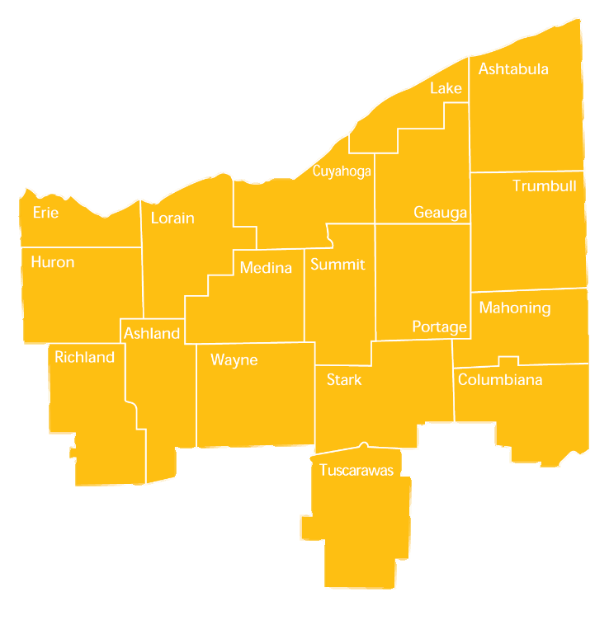
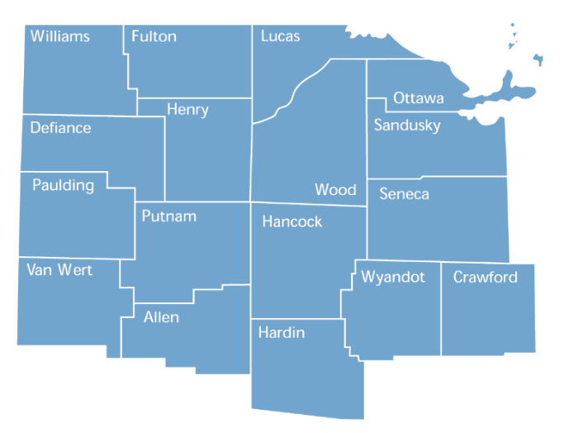
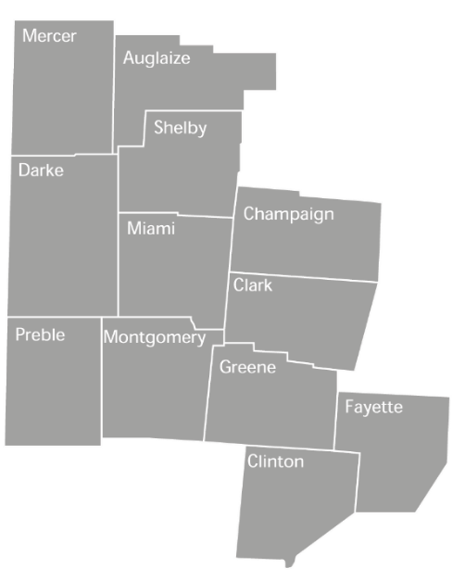
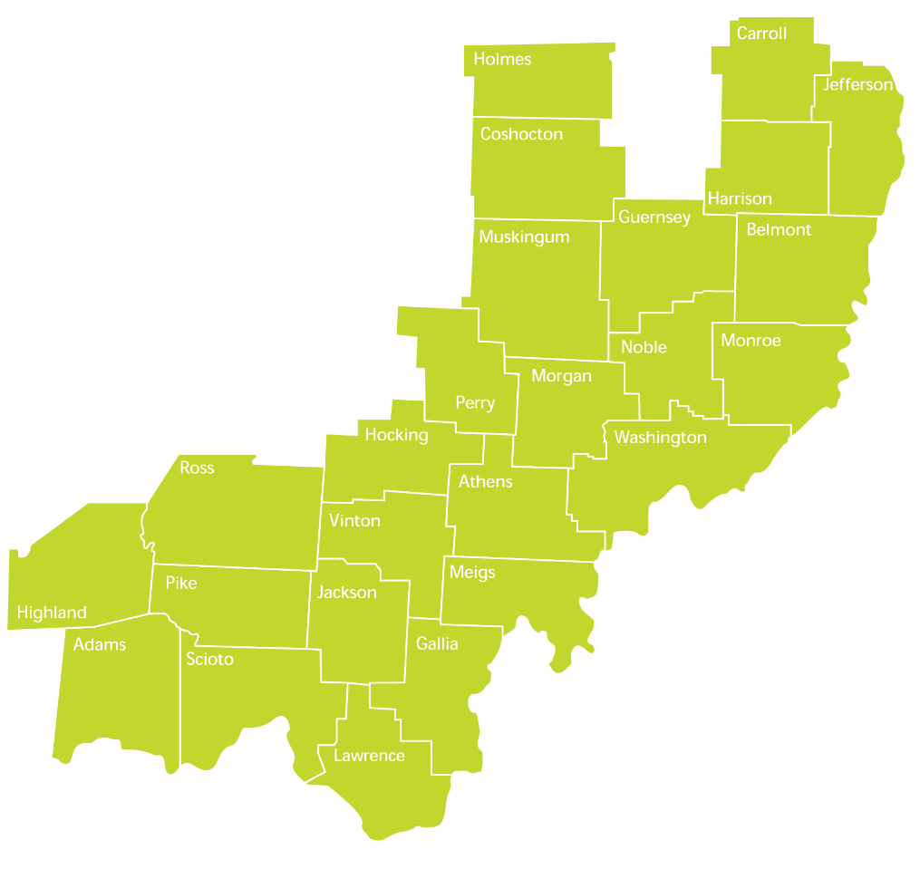
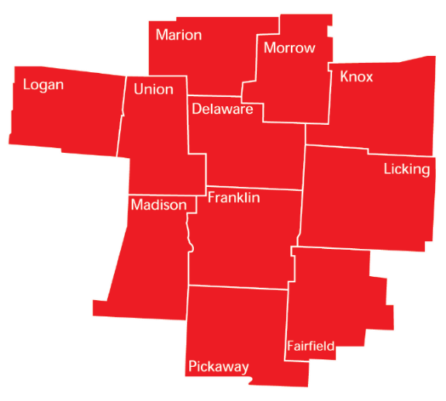
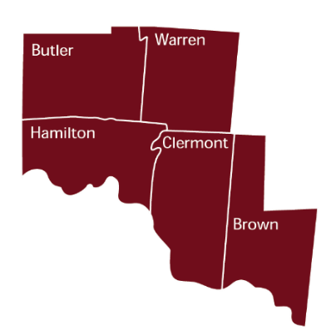
Northwest Ohio
Registered Nurses
Nursing Aides
Team Assemblers
Office Clerks
Tractor-Trailer Truck Drivers
Licensed Practical and Vocational Nurses
Farmers and Ag Managers
Machinists
Customer Service Reps.
First-Line Supervisors of Food Prep and Serving Workers
West Ohio
Registered Nurses
Customer Service Reps.
Office Clerks
Nursing Aides
Team Assemblers
Licensed Practical and Vocational Nurses
Tractor-Trailer Truck Drivers
Farmers and Ag Managers
Medical Secretaries
Tellers
Central Ohio
Registered Nurses
Customer Service Reps
Office Clerks
Nursing Aides
Team Assemblers
Tractor-Trailer Truck Drivers
Licensed Practical and Licensed Vocational Nurses
Medical Secretaries
Accountants and Auditors
First-Line Supervisors of Retail Sales Workers
Southwest Ohio
Registered Nurses
Customer Service Reps
Office Clerks
Nursing Aides
Licensed Practical and Vocational Nurses
Accountants and Auditors
General and Operations Managers
Medical Secretaries
Maintenance and Repair Workers
Sales Representatives
Northeast Ohio
Registered Nurses
Office Clerks
Customer Service Reps
Nursing Aides
Licensed Practical and Vocational Nurses
Tractor-Trailer Truck Drivers
Medical Secretaries
Accountants and Auditors
First-Line Supervisors of Retail Sales
Secretaries and Admin. Assistants
Southeast Ohio
Registered Nurses
Farmers, Ag Managers
Office Clerks
Nursing Aides
Licensed Practical and Vocational Nurses
Tractor-Trailer Truck Drivers
Construction Laborers
Tellers
Maintenance and Repair Workers
Medical Secretaries

Slide 27
Postsecondary Credentials
What is a postsecondary credential?
  Associate’s Degree?
  Bachelor’s Degree?
  Industry recognized credential?
  ALL students can attain or make progress toward postsecondary credentials while in high school and beyond. Today ALL students can graduate with some college.

Slide 28

Industry-Recognized Credentials
Important for ALL students
Can be used to mitigate risk
Can earn postsecondary credit

Slide 29
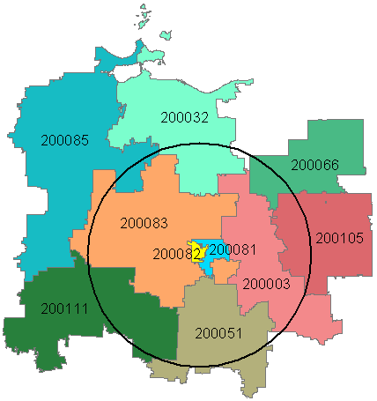
Creating Pathways
Fulfilling employer hiring needs: A pipeline of future employees

Slide 30
Increasing Student Options
Create pathways at the high school starting as early as grade 7
  Align pathways to programs at area Career Center and Community Colleges
Develop credit flexibility plans for work-based learning
Start a Personalized Pathway Program (P3)
Develop an industry credential only program

Slide 31
Personalized Professional Pathway (P3)
Provides schools a way to diversify their pathway offerings and place more students in work-based learning.
  Class on employability skills aligned to OMJ Readiness Seal
  Requires work-based learning aligned to technical content standards
  Credit flexibility in CTE

Slide 32
Credential Only Pathway
Industry recognized credential
12-hour teaching permit
  Example: School nurse teaching to STNA or phlebotomy credentials

Slide 33
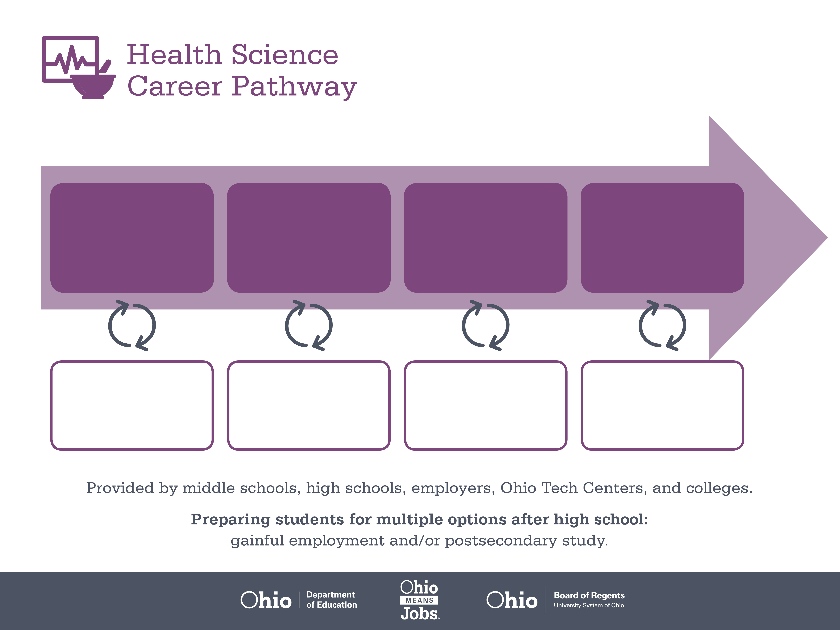
Certificate,
Dental Assisting
Associate or Bachelor’s
Degree, Dental Hygiene
Doctoral Degree,
Dentistry
Start Pre-Health
As early as grade 7
(based on readiness)
Dental Assistant
Median Salary: $33,690
Job Growth (10 yr): 20.5%
Annual Openings: 416
Average Tuition (1 yr): $0 –$3,900/yr
Dental Hygienist
Median Salary: $65,510
Job Growth (10 yr): 26.3%
Annual Openings: 345
Average Tuition (2 yrs): $3,900/yr
Average Tuition (4 yrs): $9,600/yr
Dentist
Median Salary: $158,460
Job Growth (10 yr): 9.5%
Annual Openings: 186
Average Tuition (4 yrs): $35,000/yr
Workplace Visits
Job Shadow
Internship
Work
Supervised Experience
---
Work
Supervised Experience
Internship
---
Work
Internship
---
Work
Ohio In-demand Occupations
Data reflects 2014 Ohio labor statistics and public institutions of higher education for 2013-2014. For specific tuition costs, visit ohiohighered.org.

Slide 34
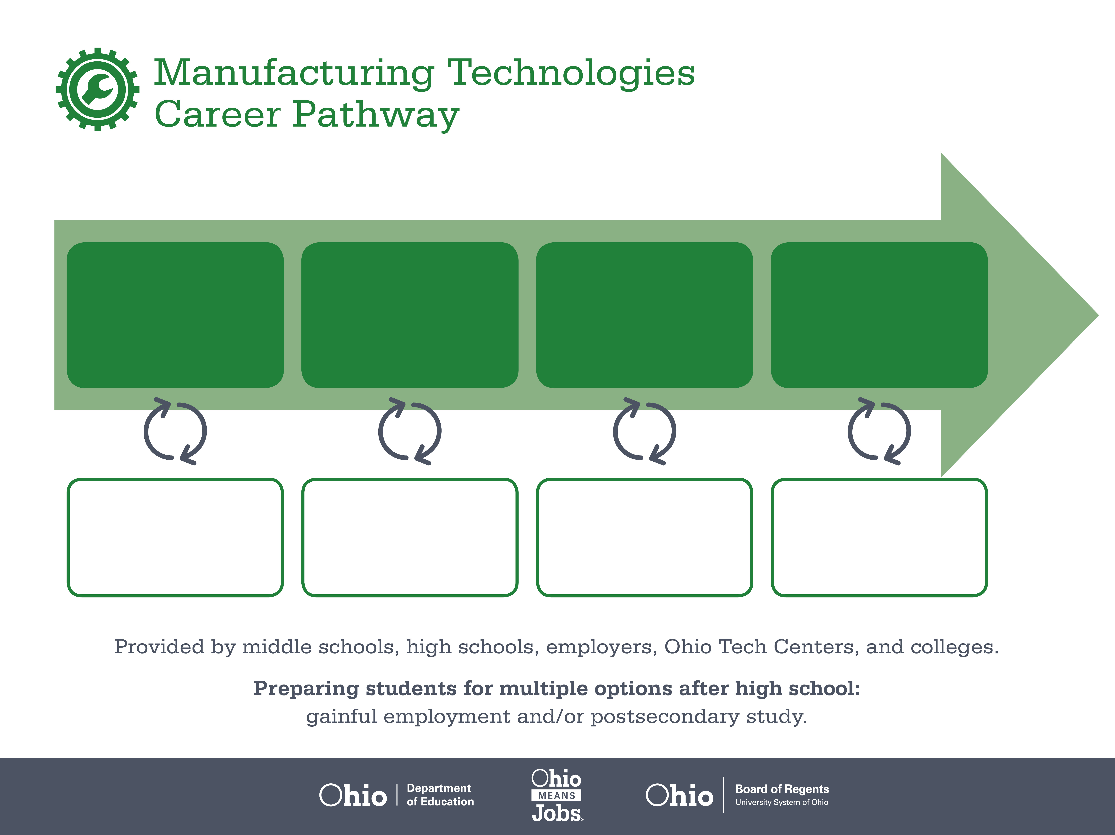

Associate of Applied
Science in Electrical
Engineering Technology
Bachelor’s Degree in
Electrical Engineering
Certificate
Start Pre-Engineering
As early as grade 7
(based on readiness)
Manufacturing Operations
Median Salary: $19.00/hour
Job Growth (x yr): x.x%
Annual Openings: xxx
Electrical Engineering Technician
Median Salary: $19.00/hour
Job Growth (x yr): x.x%
Annual Openings: xxx
Average Tuition (1 yr): $0-$2,400/yr
Electrical Engineer
Median Salary: $xx,xxx
Job Growth (10 yr): x.x%
Annual Openings: xx
Average Tuition (4 yrs): $xx,xxx/yr
Work, Earn, and Learn
Workplace Visits
Job Shadow
Internship
Work
Full-time work in the summer, part-time work during the school year.
$19.00 per hour and college credit
Full-time work in the summer, part-time work during the school year.
$19.00 per hour, up to $2,400 in scholarships
Work

Slide 35








OhioMeansJobs-Readiness Seal

Slide 36
Next Steps
Analyze regional and local data
Work with area and regional partners
Identify resources
Become a SuccessBound coach
Enroll in SuccessBound courses & training
Share quick wins and promising practices

Slide 37
Goal for Each Child
Enrolled and succeeding in postsecondary education/training
Serving in the military
Earning a living wage

Slide 38

successbound.ohio.gov

